Slide 1

Retail Makeover
Business Case Study
Why “Digital” is the New Black!

Slide 2
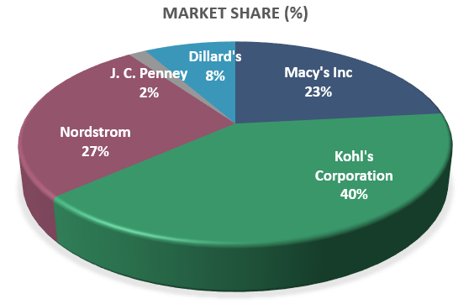
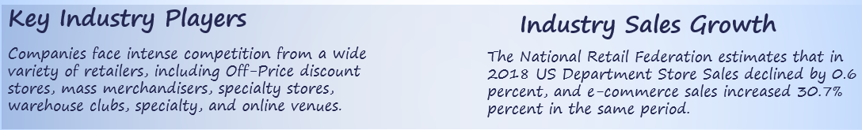
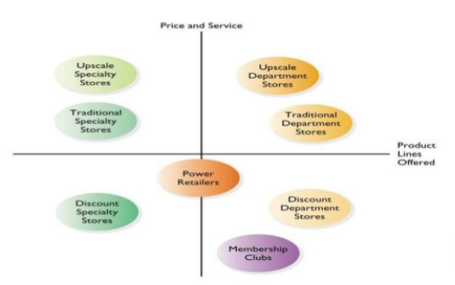
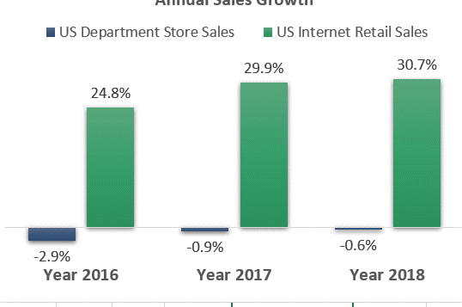
US Department Stores Industry
Department stores in the United States are large retail establishments that offer a wide range of products in several different departments including but not limited to; apparel, accessories, home goods, electronics, cosmetics, and sporting goods.
The industry is comprised of 20 companies that operate about 3,250 stores with a combined annual revenue of $29,597MM. Market share concentration for the industry is highly concentrated, with the three top companies accounting for 90% total industry revenue volume year-to-date.
Key Industry Players
Industry Sales Growth
Companies face intense competition from a wide variety of retailers, including Off-Price discount stores, mass merchandisers, specialty stores, warehouse clubs, specialty, and online venues.
The National Retail Federation estimates that in 2018 US Department Store Sales declined by 0.6 percent, and e-commerce sales increased 30.7% percent in the same period

Slide 3
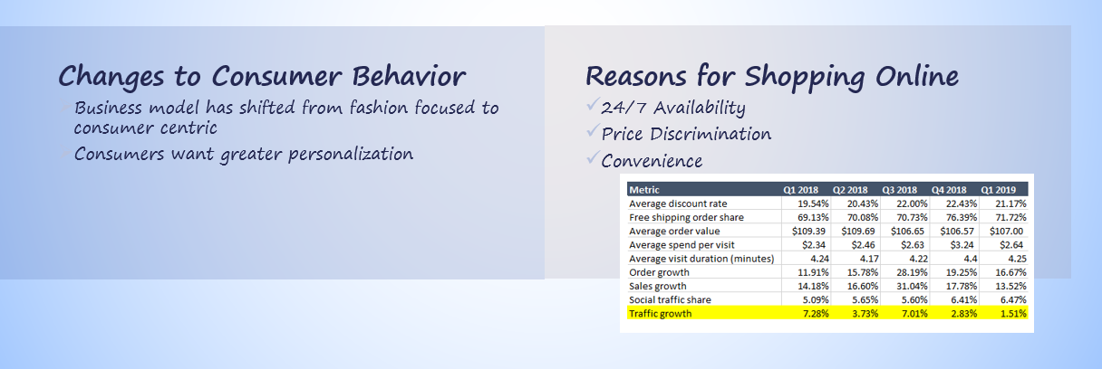
Clicks Vs. Bricks
Technology and changes to consumer behavior, particularly among younger consumers, are disrupting the retail industry. According to the Financial Times, Amazon is poised to overtake Macy's as the biggest US seller of apparel (a major category for department stores), Department stores also face competition from other digital retail platforms, such as Stitch-Fix, eBay, etsy, Zulily and Wayfair.
-
-

Slide 4

Why?
Advances in technology innovation and shifts in consumer behavior has led consumers to shift spend from offline to online.
In-store foot traffic continues to decline as shoppers look to time savings and price discounts by shopping online from the convenience of their home.
As a result, department stores seen a steady decline in profitability, driven by poor inventory turnover and force price markdowns.
Year-to-date, more than 10 multichannel retailers have closed their 8,600 stores and 68 retailers have filed for bankruptcies.
Unless Department Stores evolves their business model that puts customer experience its top priority to meet the changing demands of NextGen consumers, the threat of the Retail Apocalypse is not so far fetched.

Slide 5

Questions of Interest
How can department stores leverage omnichannel capabilities to enhance customer experience and win back lost market-share?
How can Department Stores optimize entire value chains to create innovative business model to reinforce competitive advantage by maximizing operational efficiency?
Potential Impacts
Customer journey experience
Reinvigorating in-store shopping
Nextgen online shopping
Seamless, frictionless all in composing shopping
Key Stakeholders
Retail Companies CEOs / CTOs
Example
Macy’s CEO – Jeffrey Gennette
Macy’s CTO – Naveen Krishna

Slide 6
Questions of Interest will be examined though
a Deep Dive Analysis of

Slide 7
Macy’s 2nd Qtr. – At a glance!
EPS
Well below expectation
Growth 150 at best in silos and stages
Inventory
Elevated post season inventory levels
Heavy price markdowns
Business
International business in declined
Vendor Direct increased online traffic
Missed opportunity on Women’s sportswear
Inventory Markdowns impacted margins
Mobile
In-Store
Increase usage & conversion
Fastest Growing
New Feature Cadence
My Wallet
My Style/Size
Improve customer experience
Enhance quick pick-up
Improve Destination business (40% of total sales)
Source: Investor Presentation 2019 2nd Q

Slide 8
Macys Performance
Advances in technology innovation and shifts in consumer behavior has led consumers to shift spend from offline to online.
In-store foot traffic continues to decline as shoppers look to time savings and price discounts by shopping online from the convenience of their home.
As a result, Macys has seen a steady decline in profitability, driven by poor inventory turnover and force price markdowns.

Slide 9


Performance Challenges
Stagnant Sales Growth
Operational Inefficiency
Low Shelf-Product Availability
Poor Inventory Turnover
Rising Delivery Costs
Same Store Sales Growth (YTD):
-1.78%
Operating Cycle:
168 vs. 60
Days Days
Out of stock Inventory on Avg.
18.5%
2.8x vs.9.1x
Increased on avg. 90 bps
per quarter
Calculations are YTD as of Q3 2019.

Slide 10
Poor Inventory Management

Slide 11
Operational Inefficiency

Slide 12
Stagnant Sales Growth

Slide 13

How can compete with digital-first retailers moving at the speed of technology?

Slide 14
Proposed Solution
Modernize Legacy Technology
Optimize existing store operations
Enhance the customer experience

Slide 15
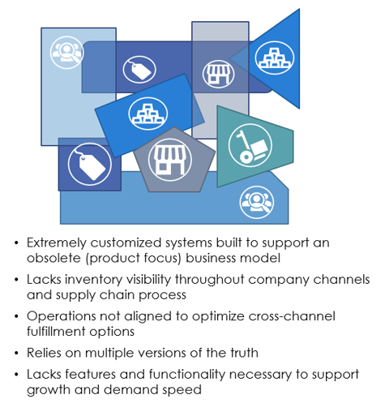
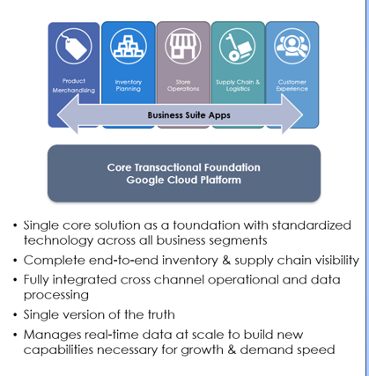
Modernize Legacy Technology
Helps create a new unconstrained eco-structure that enables Macys to deliver the agility & speed necessary to stay competitive
Legacy Architecture
Disparate & Unresponsive
Transformed Architecture
Ready for Unified Commerce

Slide 16








Proposed Architecture
Tablet
In-store
Customer Recommendation
Mobile
online
Customer Touchpoints
Custom App Push-notification
Customer Clicks
Transactions
Signals
Engagements
Customer Experience Platform
Customer
Content
Other
Optimization
Personalization
Continuous Optimization
Data Management
Extract
Transform
Load
Train
Recommend
AI/Machine Learning/Analytics/Integration
Continuous Learning
Inventory
Sales
Supply Chain
Marketing
Payment
Merchant/Supplier
Legacy Systems/Application

Slide 17







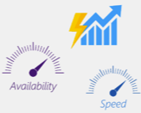


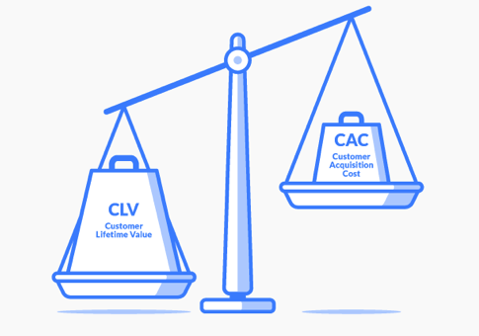


Example Use Case
Customer Application
Messages
Personalized Promotions
Order Confirmations
Order pick-up
Tablet
In-store
Mobile
online
Welcome
Back!
Here’s what you’ve
Missed..
Serverless Customer Messaging
New Customer
/Users/{uid}/customers/{id}
Personalized Promotions
Win-Win
Technology Savings
Increased foot-traffic
Increased loyalty
Higher Customer Savings
Pay only for what you use
event-driven scaling
Low CLV:CAC
Most Profitable Customer
Intimate Customer Relationship
No Servers to manage
Quick deployment

Slide 18
Optimize existing store operations
Elimination of silos enables Macys to increase overall productivity by utilizing each store as a fulfillment and customer interaction center.
Opportunities for maximizing operational efficiency:
Product
Merchandising
- Price reduction optimization
- Cross-channel analytics
- Point-of-Sale solutions
- Dynamic assortment planning
Inventory
Planning
- Demand forecasting
- Reduce inventory carryover
- Gain insight at SKU level
- Improve inventory accuracy and visibility
Store
Operations
- Frictionless checkout
- Instore replenishment optimization
- Store optimized planograms
- Reduced working capital
Supply Chain
& Logistics
- logistical scenario modeling
- Driver-based analysis
- Optimize carrier utilization
- Fulfillment Optimization
- Delivery Cost Reduction Model
Customer
Experience
- Customer acquisition & retention
- Personalized digital marketing/promotion
-Data-driven segmentation
Harness AI and Machine Learning capabilities to improve inventory accuracy, tighten control of merchandise stock replenishment, and optimize fulfillment ordering
By digitizing information-intensive processes, costs can be cut by up to 90 percent and turnaround times improved by several orders of magnitudes

Slide 19

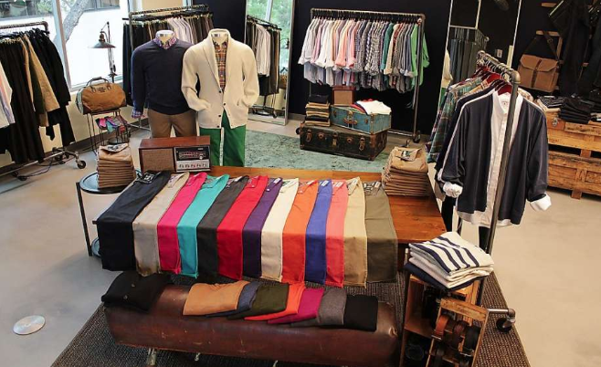
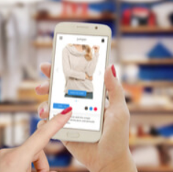
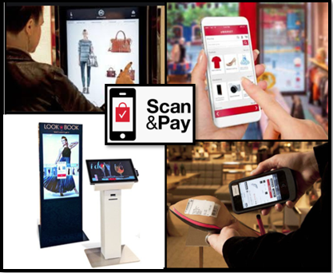
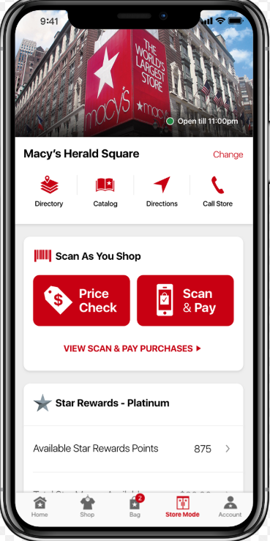
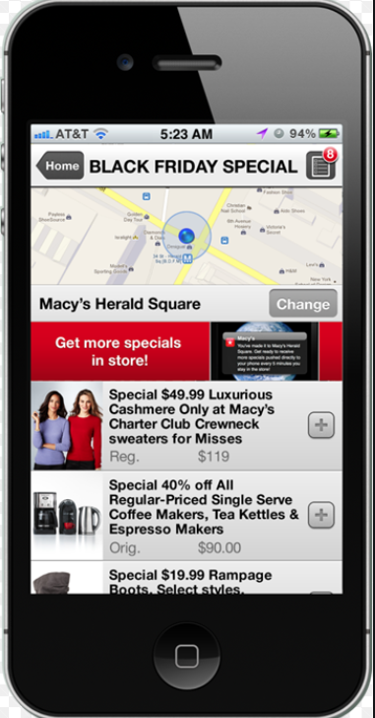
Enhance Customer Experience
Strengthen relationships by using real-time consumer analytics to enhance personalization
Macys can offer consumers an experience surpassing that of online retailers by uniting traditional in-store advantages with key success elements of the digital experience
Leverage nondigital “touch & feel” attributes to optimize product assortment
Remove consumer pain point by offering frictionless checkout

Slide 20
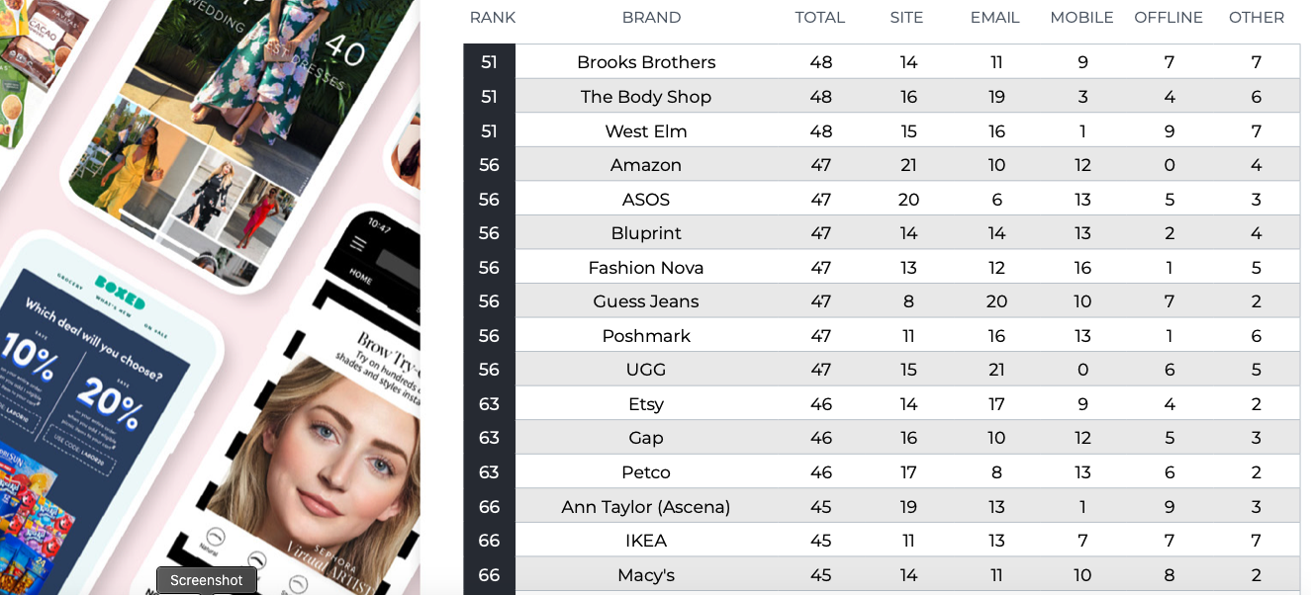
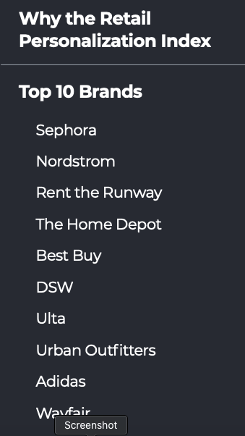
Macy’s place on Personalization Index!
Utilize retail solutions of Google Cloud Platform
2019 Sailthru® Retail Personalization Index
Total | Site | Email | Mobile | Offline | Other
45/100 | 14/26 | 11/25 | 10/20 | 8/10 | 2/19
Personalized marketing results in retailers’ sales increasing by 6 to 10%, two to three times higher than their non-personalizing competitor.

Slide 21
Mobile Experience
Mobile Sales 10% of total digital sales Vs.
Industry Average 20%

Slide 22
Technology Runway
Can Macy’s be a show stopper on Technology Runway?
Real-time analytics
Increased revenue
Machine Learning
Reduce inventory carryovers 50%
Big-Data Query
Black Friday turnover up 50%LY
Enhanced Customer Exp.
Demand planning accuracy QoQ
Aggregate data sources for improved analytics.
Starters
Stoppers
Google Cloud Data warehousing /analytics
Streamline retail operation across network for ship/rec. sorting, ticketing etc..
Google App Engine
Access in-store data in 2.5 sec.
Helps high-street retailers identify in-store customers.
Cloud Native Arch.
10x faster deployment
Cloud Storg. & Analy
17% inc. ROI in online adv.
TenserFlow & Kubernetes
Processes data in minutes Vs hours!!
Huge recourse savings in DevOps & IT
250M size reco./mo for top apparels boost conversion/reduce returns
Same-day new service deply. Vs 1-2 weeks!!
laggard
leaders
Source: Google Cloud Platform as of 2nd Q 2019

Slide 23





Macy’s Vs Zulily
Founded in 1858
~$25B rev. in 2017
1.4% Buyer
Avg. Spend
$35
91% anonymous
9% Registered
7% Engaged
59 million/month
Registered
Engaged
Buyer
Site visitor
Founded in 2009
$365m rev. in 2016
9 million/
month
23% anonymous
77% Registered
4% Buyer
Avg. Spend
$55
20% Engaged
Is data or customer really an issue for Macy’s?

Slide 24
How to be show stopper again?

Slide 25
Customer Intimation – Dr. Bailo’s Law
Feelings
By personalization
Actions
By engagement
Productivity
By personalized recommendation for positive engagement
Revenue
F-A-P results into higher revenue driven by increased customer engagement.
Talent

Slide 26
Key Focus Areas of Improvement
Customer Data Mining
Machine Learning
Digital Analytics
Cloud Technologies
Serverless Computing
In-store
Automation
IT Operational
Efficiency
Talent

Slide 27
Leverage GCP!!
Cross-Channel Commerce
Merchandising
&
Assortment
Operation
Product Lifecycle Management
Logistic, Fulfillment
&
Delivery
Customer Acquisition
&
Retention
Reduce Purchase Friction
Digital Shopping Assistant
High-performing product recommendation
Engage customer
Cross-channel analytics
Point-of-Sale solutions
Dynamic assortment planning
Frictionless checkout
Use AI/Image recognition to track on-shelf inventory
Demand forecasting
Reduce inventory carryover
Gain insight at SKU level
Real-time inventory management
Improve inventory accuracy and visibility
Customer acquisition and retention
Personalized digital marketing/promotion
Leverage GC H₂O.ai instead of R
Google Retail Cloud Solutions
Source: Google Cloud Platform

Slide 28
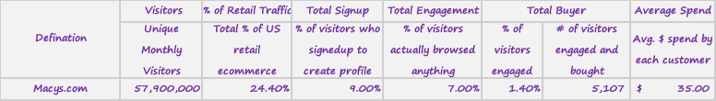
Opportunity!
4% Increase in Conversion by 3Q 2020
3% CLV growth
by 2Q 2020
2.5% Revenue growth by 3Q 2020
2% increase in Op. Efficiency by 4Q 2020
2% increase Customer growth by 4Q 2020
Source: Investor Presentation 2019 2nd Q

Slide 29





Restructuring
Naveen Krishna, CTO
VP IT Operation
VP Customer Exp.
VP Digital Design
DevOps
Developers
PM
Architects
QA
Implementation
Deployment
VP Marketing
VP Supply Chain
VP Product
VP Data & Analytics.
Customer Experience Platform
VP IT Infrastructure
Legacy Systems/Application

Slide 30
What’s in it for Macy’s ?

Slide 31










W-I-I-F-Macy’s?
Customer data access in seconds vs. days
Higher visibility on in-store customers
Reduced data ingestion period, increase efficiency in data handling
Higher Cust. Insight
Increased personalization
Enhanced customer exp.
Higher customer spending
Increase revenue
Targeted marketing
Reduced returns
Size recommendation
Optimized retail IT operation
Reduced inventory carryover
Demand Planning
Increase revenue from online ad spending
Improve DevOps/IT resources + savings
Increase Black-Friday Sales
10x fast deployment
Same day Vs weeks
Leverage Cloud
Revenue & Efficiency
Cloud Native Architecture
Google Cloud Bigdata Query
Machine Learning
Cloud Storage Analysis
Google Cloud App Engine
Google Real Time Analytics
Tenser-flow & Kubernetes
Google Cloud Data warehousing /analytics
Q1
Q2
Q3
Q4
FY 2020

Slide 32
Top-line and Bottom-line Benefits

Slide 33
Data Analysis

Slide 34
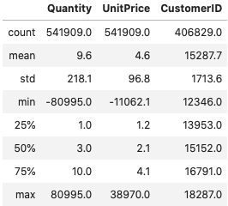
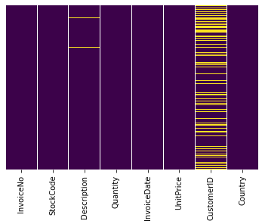
Customer Data Description
Missing Data
Attributes

Slide 35
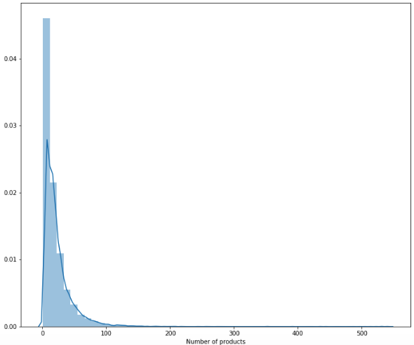
Customer Buying Patterns
Clearly excessive inventory appears to be an issue.
It is reflective of unnecessary price markdown due to inventory.
limited SKU’s purchased by bulk of the customers
We believe that personalization at individual customer level can help somewhat alleviate excessive inventory!
It also helps streamline inventory turnover cycle and perhaps reduced up to 50%

Slide 36
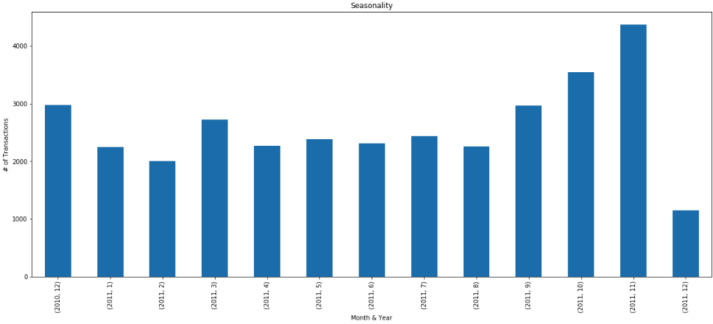
Seasonality
Clearly reflects the holiday purchase peak!

Slide 37
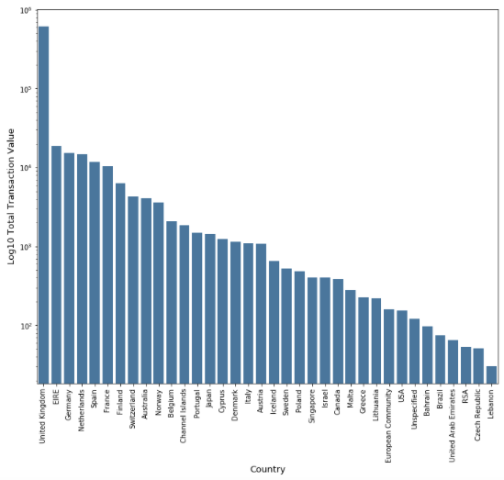
Average Transaction Value
USA

Slide 38
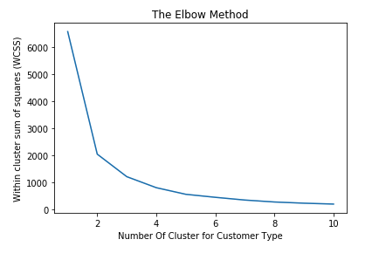
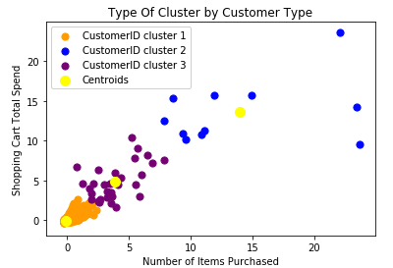
Customer Clustering

Slide 39
Summary of Analysis
We employed all our learnings from the MSDS program for the Retail Customer Spending data.
Our analysis were limited to given data constraint.
We like to have more data to continue our analysis
More granular customer behavior data
Most recent data at least 3 years
We were able to analyze transaction/yr., # of orders/customer
Highest spending customer
The observation of 'per customer baskets' and their value enabled customer clustering.

Slide 40
Appendix

Slide 41
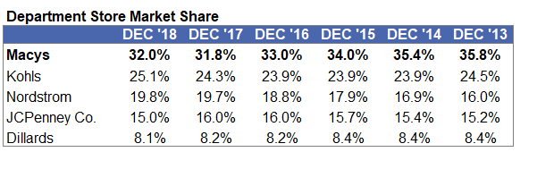
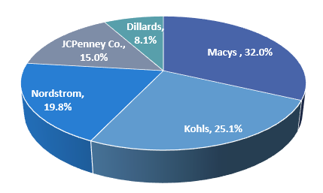
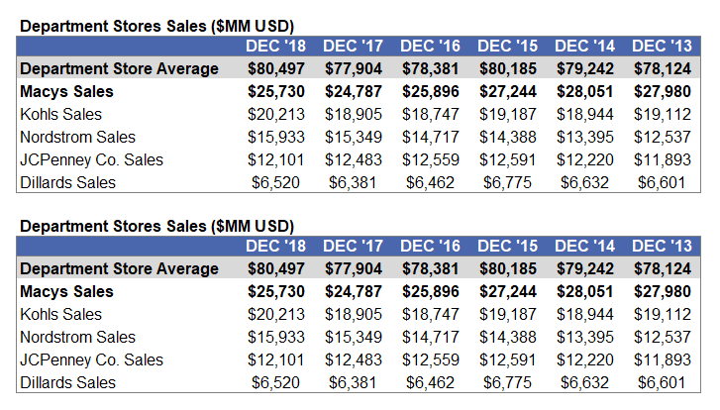
Appendix: Financial Growth Measures

Slide 42
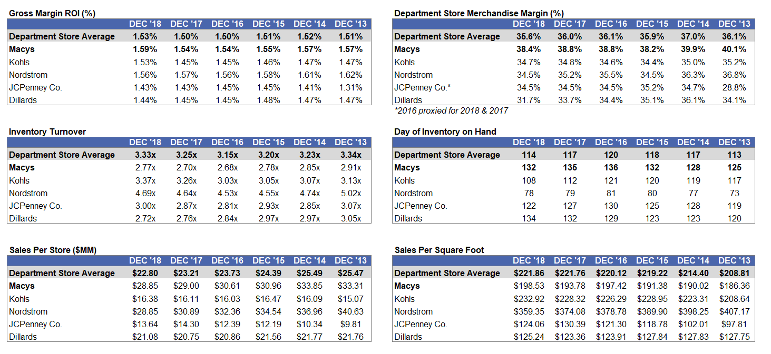
Appendix: Efficiency Financial Metrics

Slide 43
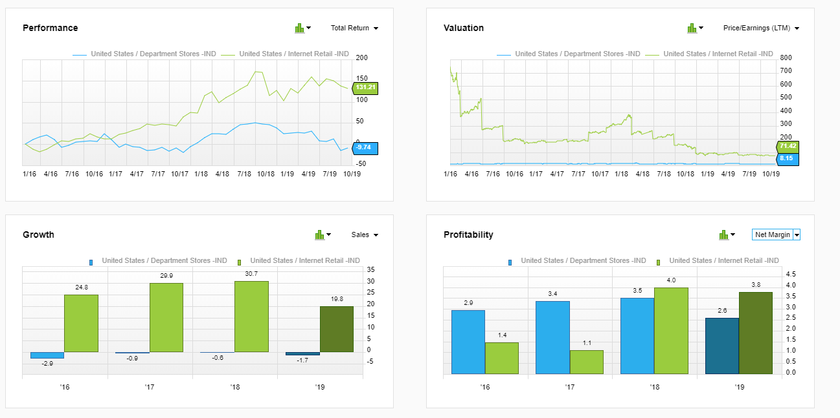
Appendix: Industry Performance

